Slide 1
Enhanced Content & Usability – Ratcheting for year 2016
WPMAT
MAT-1.3.2-T007-D002
James Gardiner, CCFE
M. Gorley, CCFE

Slide 2
Written objectives for 2016
Identify method for prediction of alternating plasticity/ratcheting boundary (3-step method).
Assess divertor and blanket with the new methods.
Simulate cyclic behaviour of Eurofer and CuCrZr (irradiated and unirradiated) with the new methods.
Investigate cyclic-softening modeling methods.
Write DDC rules for shakedown & ratcheting.
Notes:
*Compare continuous calculations with 5-step start yield/end yield simplification method.

Slide 3
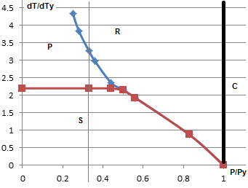
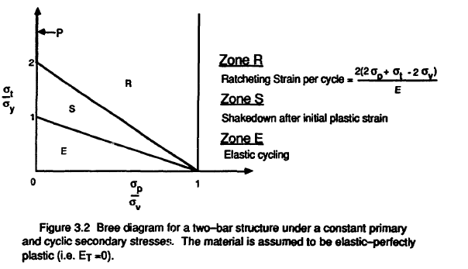
Alternating plasticity/ratcheting boundary (3-step method) & assessment of divertor
We identified a lower-bound method of predicting whether a component was in the ratcheting, alternating plasticity or shakedown region of the Bree diagram (right).
Further work has indicated that the P zone may not exist in the Divertor and that the Bree diagram seems more like that of a 2-bar assembly (below) than a classic Bree pipe.
Also, in an Iter-style divertor if the the copper ring is allowed to remain plastic then it will likely promote ratcheting.
So we cannot assess different materials in isolation which further undermines the use of elastic assessment methods.

Slide 4
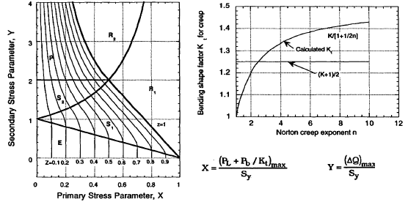
DDC: Creep ratcheting – method 1; theoretical
ASME III subsection NH uses Bree diagrams already so any method that can reproduce a Bree diagram can use a modified version of this procedure. They have 2 diagrams; a classic thin cylinder and a general diagram (based on classic 2-bar assembly).
A Kt factor is derived from the Norton creep power law parameter, n.
A similar Kt value could be applied to the yield stress in the 2/3 step method to predict creep ratcheting.
Z = X.Y (in S2 and P) or Y + [1 – (1-X)] ^{0.5} (in S1) or X (in E)
Effective creep stress, Sc = Z.Sy ---> creep strain limited to 1%, 2%, 5%
Problems are a) limited material applicability, b) it makes no sense to just pre-multiply Pb.

Slide 5
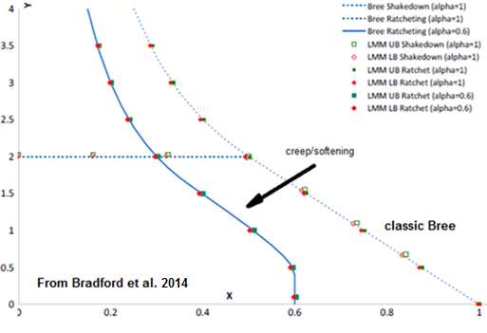
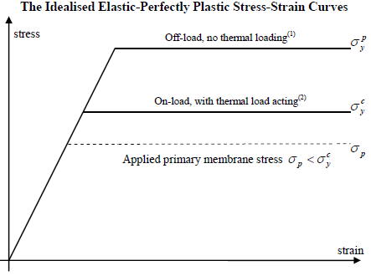
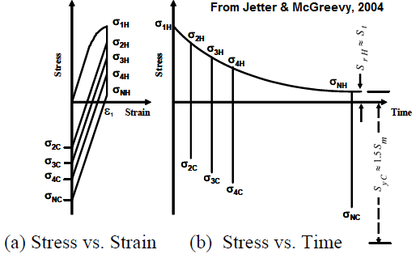
DDC Creep ratcheting – method 2; empirical
Using the uncrept cold and fully crept (at time, t) hot yield strengths in a 2/3 step analysis will allow creep ratcheting to be predicted directly.

Slide 6
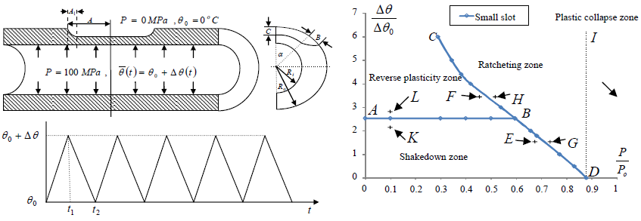
DDC: Failure assessment – erosion/corrosion
The 2-step / 3-step method is useful for assessing defects and a slightly different 2-step method has already been proposed as an amendment to API579.

Slide 7
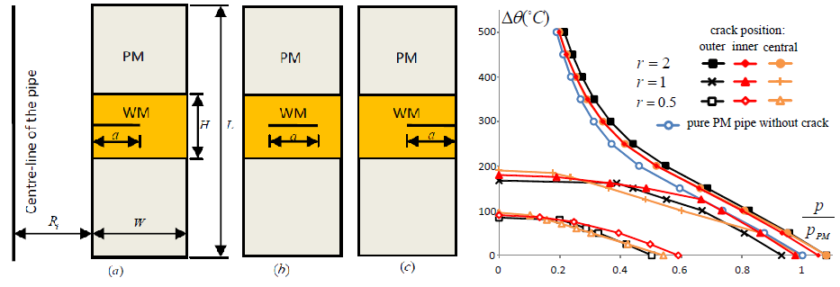
DDC: Failure assessment - cracks
The 2-step / 3-step method can be used for assessing cracks and a similar method (LMM) has already been proposed as an alternative to R6.

Slide 8
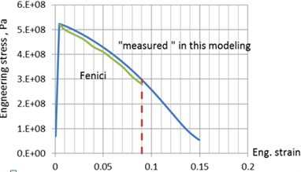
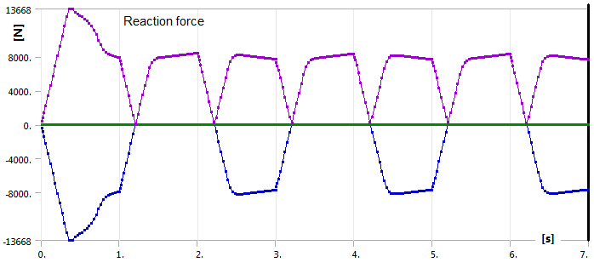
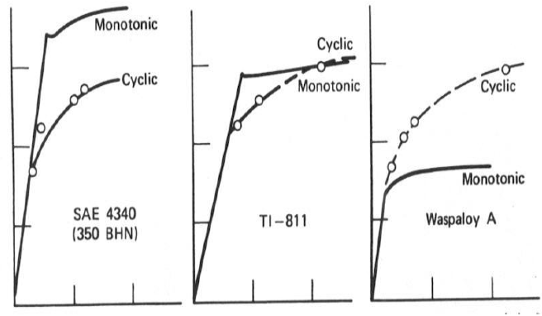
Cyclic softening : what is the real problem?
Actual softening (eg by irradiation) can be emulated in FEA by specifying a new stress/strain curve.
Testing indicates that most (or all) of the softening comes out on the first cycle followed by stabilisation. This is due to local high plasticity and general elastic strains both missing the softening part of the curve.
However cyclic-softening is really just a poor way of describing reduced hardening so it is not clear how using a softening curve is justifiable or how such a curve would be obtained from the cyclic data.

Slide 9
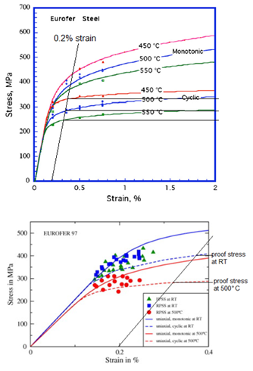
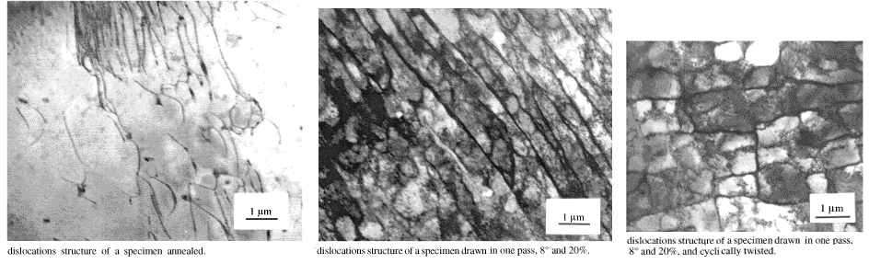
Cyclic softening by the 2/3 step methods
The ‘hardening’ extrapolations from the curve-fits have been very optimistic.
This reduced hardening is very similar to the elastic-perfectly-plastic model already required by the 2/3 step methods.
But what is the mechanism behind cyclic softening? Material tests show that it involves the elimination of dislocations.
Annealed state-> cold-work hardened->reworked softening

Slide 10
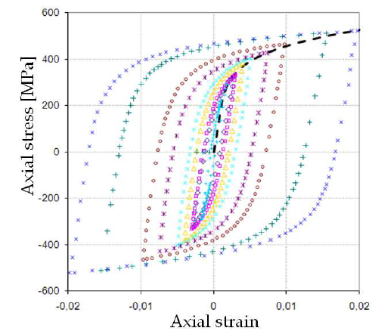
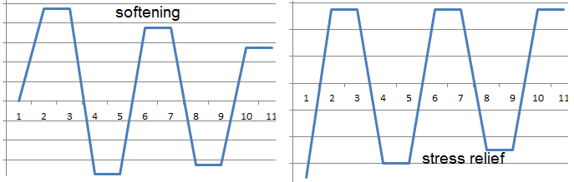
Cyclic-softening : the mechanism
Not driven by temperature change.
Takes place in the first few cycles, so does not affect high-cycle fatigue.
Is reversible by subsequent monotonic strain, so is not pernmanent.
Materials which show cyclic softening between cycles show normal hardening under both monotonic loading and within the cycles.
The smaller the hysteresis loop, the slower the softening.
The material must be initially hardened by cold working or heat treatment for softening to occur.
All this is consistent with work-softening; ie the mechanical relief of residual stresses!
Cyclic stress strain diagrams start at the origin because stress = force/area.
Hence compressive residual stresses are not represented.
mysterious ‘cyclic-softening’ versus well-known ‘work softening’

Slide 11
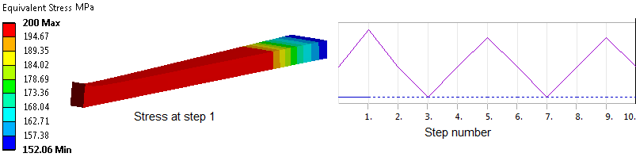
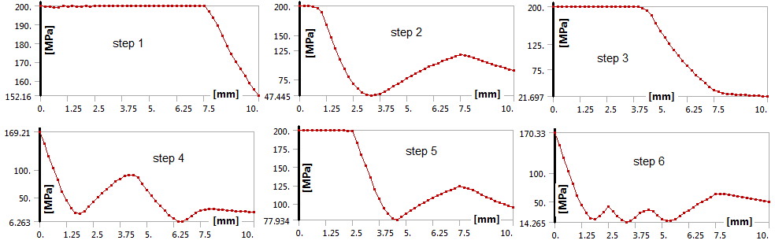
Cyclic work softening - example
0
Step 2 introduces a residual stress. This is relaxed by reverse loading in step 3 and by reloading on step 5.

Slide 12
Cyclic softening - working hypothesis
Ratcheting during cyclic tests causes an apparent softening but this is really a relaxation of compressive residual stresses that reduces the tensile load capacity. The cyclic stress-strain diagrams are misleading by starting at zero stress & strain (from Force/Area) and so not showing the initial residual stresses and subsequent stress relief.
Implications;
Softening during tensile loading cannot happen without compressive residual stresses. This is already observed.
Softening is driven by mechanical loads, not thermal except by elastic follow-up.
Load reversal increases softening so we need on/off tests rather than push-pull tests. Also observed.
Chaboche-type curve-fitting of the cyclic stress-strain curve simulates a load & geometry dependent effect rather than a cause. Inducing initial residual stresses in the model may be more effective.
If ratcheting is avoided (by the 2/3 step assessment rules) then cyclic softening is automatically avoided too.

Slide 13
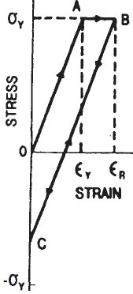

Investigation of intermediate plasticity upon unload; simulation and implications
A concern was raised that applies uniquely to a tungsten divertor where there was an apparent plastic interruption in the normal elastic unload. This occurs at the temperature transition between ductile and brittle behaviour.
In reality you can only achieve this by pretending a brittle material can still act as a plastic material and this can only happen in the model, not in real life.
In reality, if any part of the load cycle has brittle material then all plasticity models are invalid, plastic stresses/strains are fictitious and Mises stress & flow rule cannot be used (max principal stress dominates).
To avoid brittle behaviour & hence cracking on unload a temperature above the brittle transition temperature must be maintained or some alloy/composite found which remains ductile.

Slide 14
Summary
2/3 step methods can be extended to creep ratcheting, so-called cyclic softening (really reduced hardening) and defect assessment.
The Divertor Bree diagram is more like that for a heated 2-bar assembly than a pipe.
Iter divertor design is crippled by differential thermal expansion and soft copper interlayer. The solution is redesign, not better stress assessment.
Ratcheting of the coolant pipe cannot be assessed by itself; the entire system must be assessed together by plastic methods. Elastic analysis by stress linearisation and categorisation across the pipe alone is unconservative.
Ratcheting causes cyclic softening so it won’t occur in the divertor/first wall if ratcheting is prevented by the 2/3 step methods.
Cyclic stress/strain diagrams are load & geometry dependent so using them in Chaboche-type models for different loads & geometries is unjustified.
Modeling of residual stresses is the way forward for detailed cyclic analysis.
Apparent irradiation ‘softening’ is well simulated by elastic-perfect-plastic material.

Slide 15
DDC rules for ratcheting 1
Progressive Plastic Deformation
2-step Shakedown Check and 3-step Ratcheting Check
A load/unload/reload Finite Element analysis is required using the linear-elastic/ideal-plastic constitutive law with Mises yield criterion and associated flow rule and the worst-case loading cycle envelope. If the residual stress after the unload step does not exceed the elastic limit Y (defined below), then the structure has achieved elastic shakedown so proceed to the high-cycle fatigue check. If the overall plastic strain at the reload step exceeds the overall plastic strain of the initial load step then the structure is ratcheting and the component has failed. If neither elastic shakedown nor ratcheting is achieved then proceed to the low-cycle fatigue check. No partial safety factors are required. The reference temperature may be (3t_{h}/4 + t_{c}/4), where t_{h} & t_{c} are the hot and cold temperatures during the cycle, or Y may be specified for different temperatures. If using mixed materials then proceed to check for fracture at the material interfaces.
Cyclic Hardening/Softening
In the preceding checks obtain Y from appropriate cyclic stress/strain curves. Alternatively use a combined nonlinear hardening/softening constitutive model which has been tested with similar structures under similar loading and found to be conservative.
Creep Ratcheting
In the preceding checks obtain Y for the hot parts of the load cycle from appropriate creep curves.
Material | Y (at reference temperature)
Ferritic steel | Yield or 0.2% proof stress
Austenitic steel | 1.0% proof stress
Steel castings | 0.2% proof stress

Slide 16
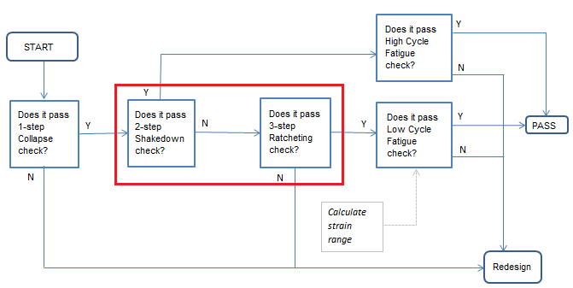
DDC rules for ratcheting 2

